Slide 1
Docker-compose
Logistics

Slide 2
Agenda
Docker compose

Slide 3
Docker. Compose
Defining and running multi-container Docker applications
Can use existing images or build from Dockerfile
Uses docker-compose.yaml file
Provide isolated environment for application

Slide 4
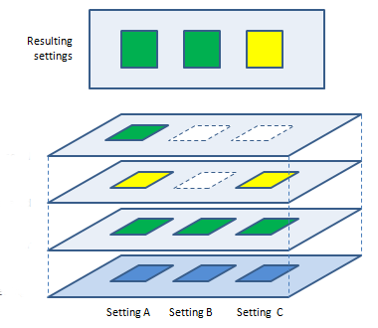
Docker. Compose file
version: '3'
services:
web:
build: .
ports:
- "5000:5000"
environment:
- VARIABLE: value
app:
image: "my_image:first"
volumes:
- ../src:/var/www
version: "3.7"
services:
...
volumes:
...
networks:
...

Slide 5
Docker. Compose file. Services
services:
frontend:
image: my-app
...
backend:
image: my-backend-app
...
db:
image: my-db
...

Slide 6
Docker. Compose file. Volumes
Create own and mount
Mount existing
Mount folder(s)
rw/ro
nfs/local

Slide 7
Docker. Compose file. Volumes
services:
volumes-service:
image: alpine:latest
volumes:
- global-volume:/mnt/global-volume
- ./app:/mnt/host-volume
- /home:/mnt/readonly-host-volume:ro
...
another-volumes-example-service:
image: alpine:latest
volumes:
- global-volume:/var/www/global-volume
...
volumes:
global-volume:

Slide 8
Docker. Compose. Demo

Slide 9
Docker. Compose file. Network
Ports expose
Network controlling
Application requirements

Slide 10
Docker. Compose file. Network
services:
network-service:
Image: centos:latest
networks:
- my-shared-network
ports:
- "80:80"
...
another-service-in-its-own-network:
image: alpine:latest
networks:
- my-private-network
ports:
- "80:80"
...
networks:
my-shared-network: {}
my-private-network: {}

Slide 11
Docker. Compose. Demo
Networks

Slide 12
Docker. To read
https://docs.docker.com/compose/gettingstarted/
https://x-team.com/blog/docker-compose-php-environment-from-scratch/
https://docs.docker.com/compose/compose-file/compose-versioning/

